Slide 1
SLB Internship and Project
Ventura Rivera

Slide 2
Self Introduction
UC Berkeley Undergrad
B.S. Chemical Engineering (Fall 2017)
Hobbies:
Exercise
Food
Exploring Outdoors and new places
Programming
Learning new skills and theories
Career Goals
Influence the world for the better with my work

Slide 3
Business Overview
District organization: Unconventional Completions – PDP segment
Basin: South Texas - Pleasanton
Clients: Pioneer, US Energy, Encana, Texas American Resources Co. (TARC)
Main Services: Plug and Perforation (PDP)

Slide 4
Internship Overview
Summary of summer
Learned about/participated in gun production at shop
Spent three weeks in field
Worked on project
One job with Manti Tarka
Pecos, TX
58 stages
Learned how to rebuild tools and toured truck
Enjoyed “busy” work

Slide 5
Project and Objective
High volume, low cost supplies
Impact gloves, latex gloves, safety glasses, o-rings, WD-40, setting tool oil, scotch locks, etc.
Problem: Difficult to track
Problem: Purchases accumulate: untracked spending
Supplies get low in Field
Hotshot
Problem: Getting hotshot wastes time and effort
Objective
Develop inventory management system tracking spending on supplies and trucks
Emphasis: Efficient, user-friendly, ability to always improve

Slide 6
Approach and Strategy
Writing a program
Efficient: Complete many tasks with user-simple command
User-friendly: Coding represented by graphical user interface with helpful features
Ability to improve: Programs can always be updated with more/updated features
VBA
Ability to use data input on spreadsheet: database application
Application scheme
Display for various trucks
Spending/Item plot outputs for trucks of interest at requested date interval
Field item calculator (for item qty. and amount)
Explosives field count

Slide 7
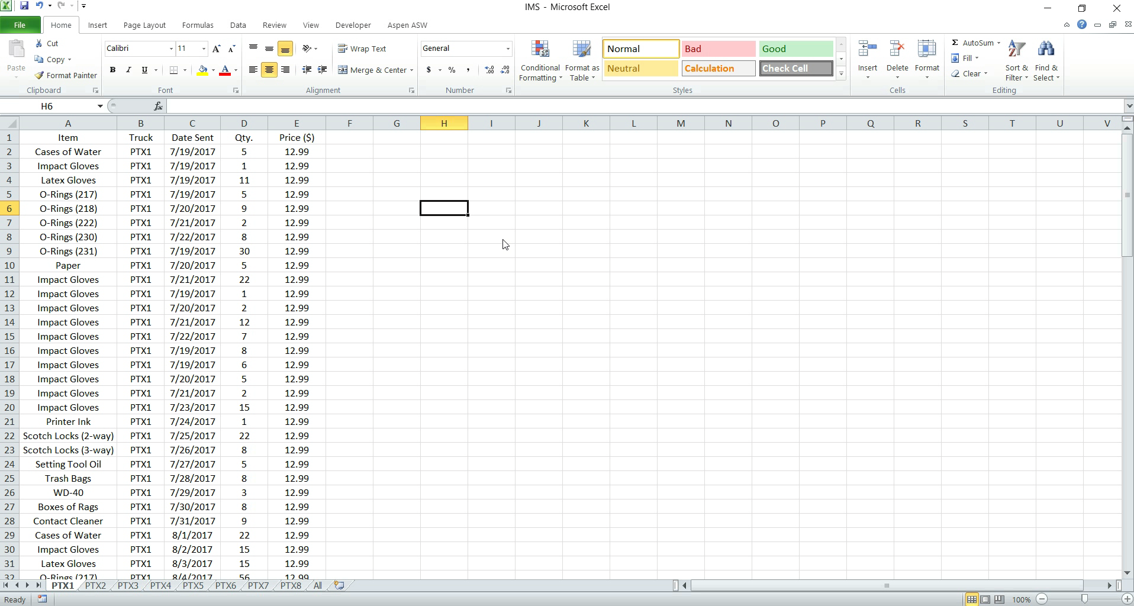
Excel Sheet Database

Slide 8
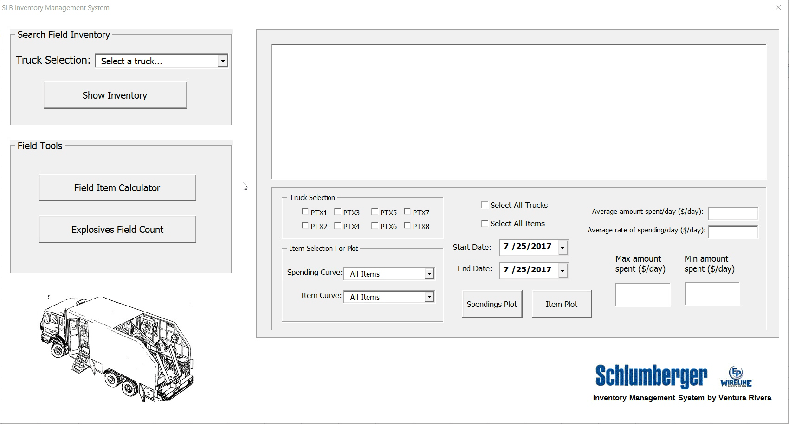
Truck Inventory History Display

Slide 9
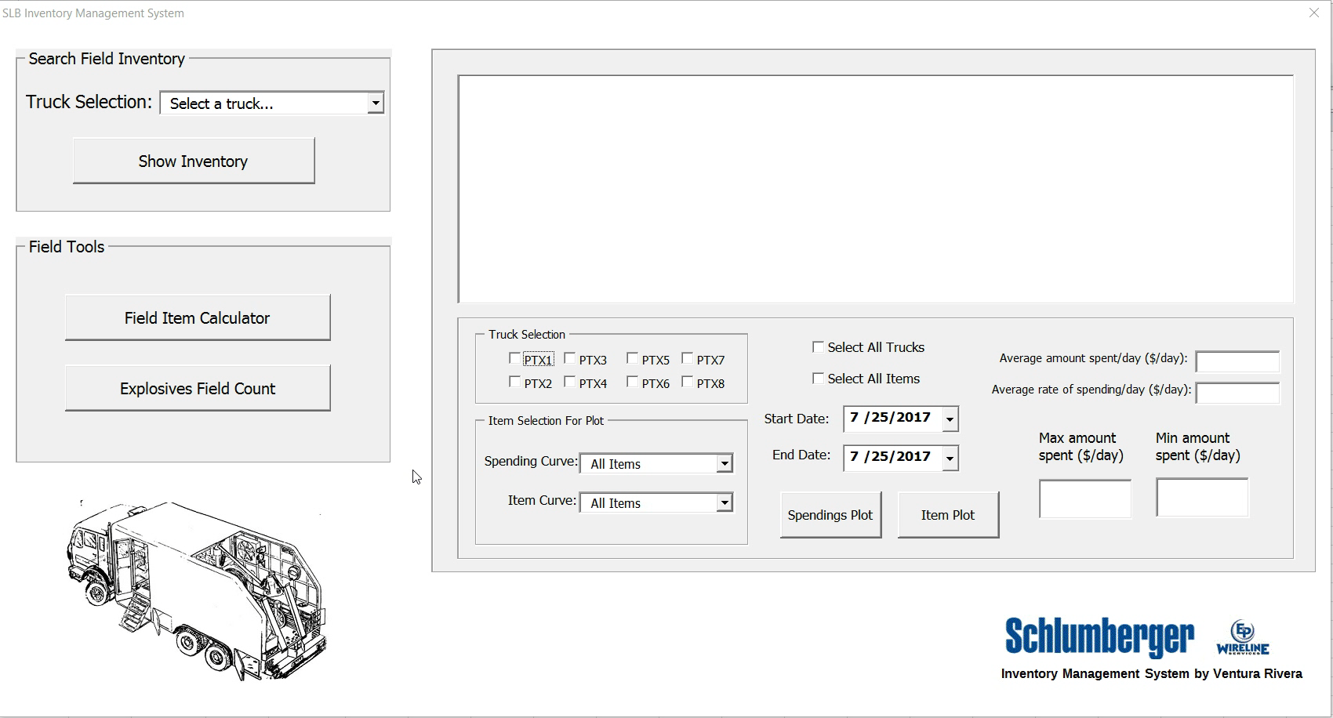
Spending/Items Plots

Slide 10

Field Inventory Calculator

Slide 11

Explosives Count

Slide 12
Future for Application
Database driven web application
Authorized access (safe)
Centralized access: from phone, laptop, tablet
Many more options!
Phone App
Business Intelligence Apps
Other Reports

Slide 13
Conclusion
Great internship experience!
Learned and participated a lot in field
Developed inventory management system
User friendly
Tracks and compares spending and supply consumption between trucks
Forecasts supplies needed and estimates cost
Has significant potential to grow/improve as an application

